Slide 1


Liefern
(Crowd-source logistic solution)
CMPE 295 B - Spring 2015
Advisor - Prof. Ashok Banerjee
Authors:
Arun Malik
Pravin Agrawal
Ram Charan Karnati
Shivaraj Patil

Slide 2


Features
Crowd Source
Peer-to-peer shipping network
True crowd sourced delivery platform that will help connect travelers and customers all around the world.
Cheaper
Liefern helps to monetize the extra carrying space of drivers that are already on their way to the destination.

Slide 3


Features
Faster Delivery
Do not wait for 2-3 days delivery. Get faster delivery from Liefern traveler on their way.
Saving Environment
Liefern doesn't add any new vehicles on the road. But make use of existing one.

Slide 4



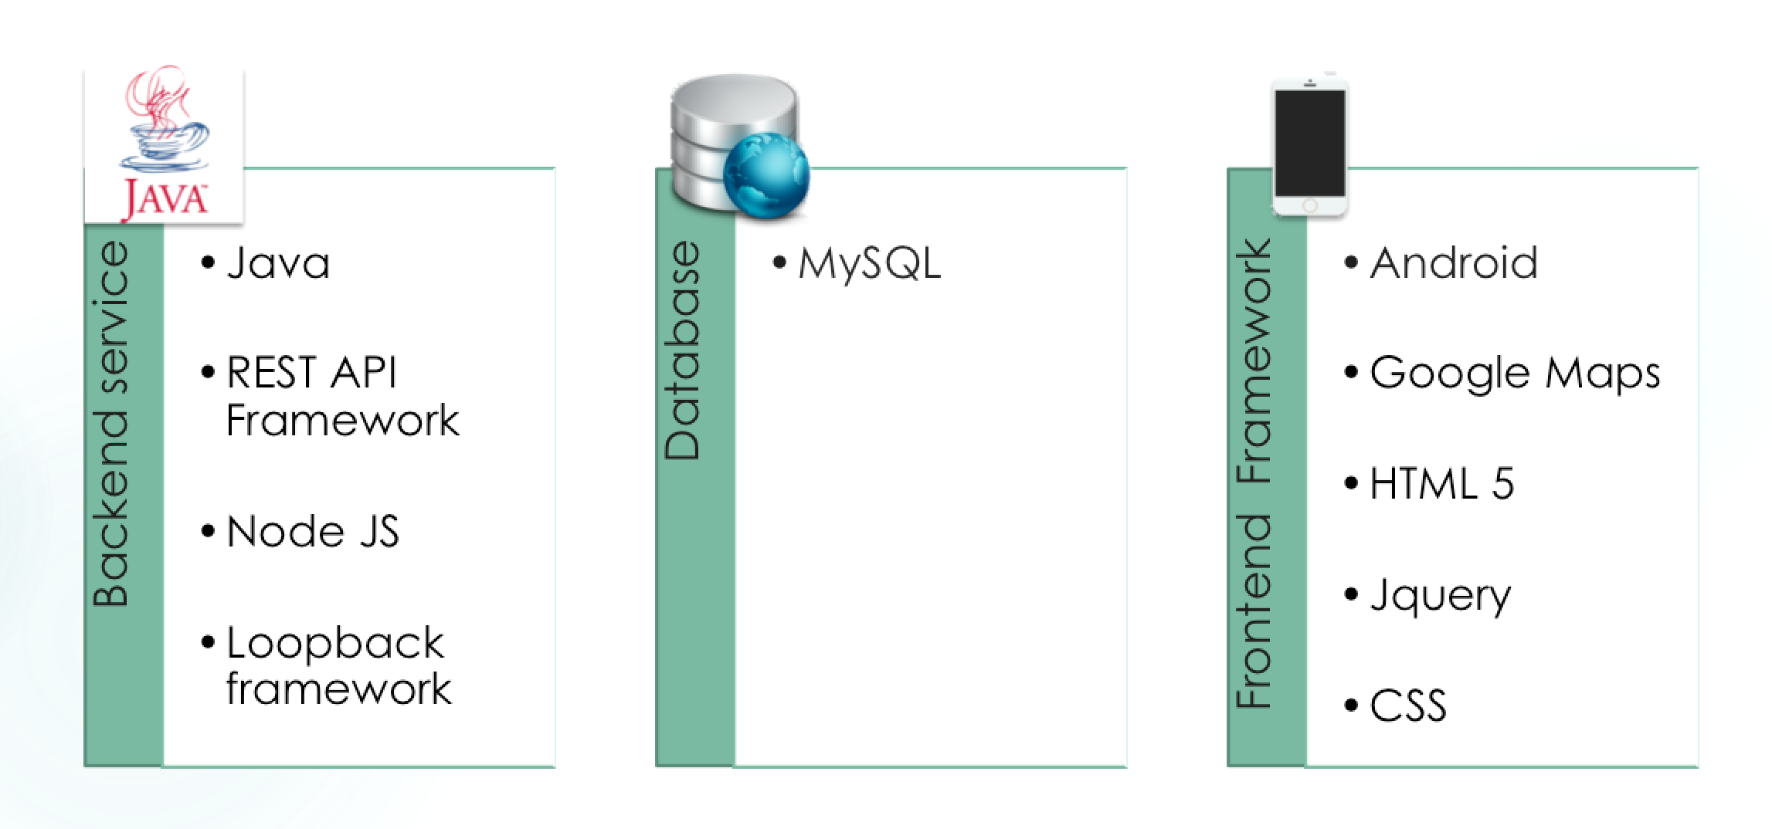
Technology

Slide 5

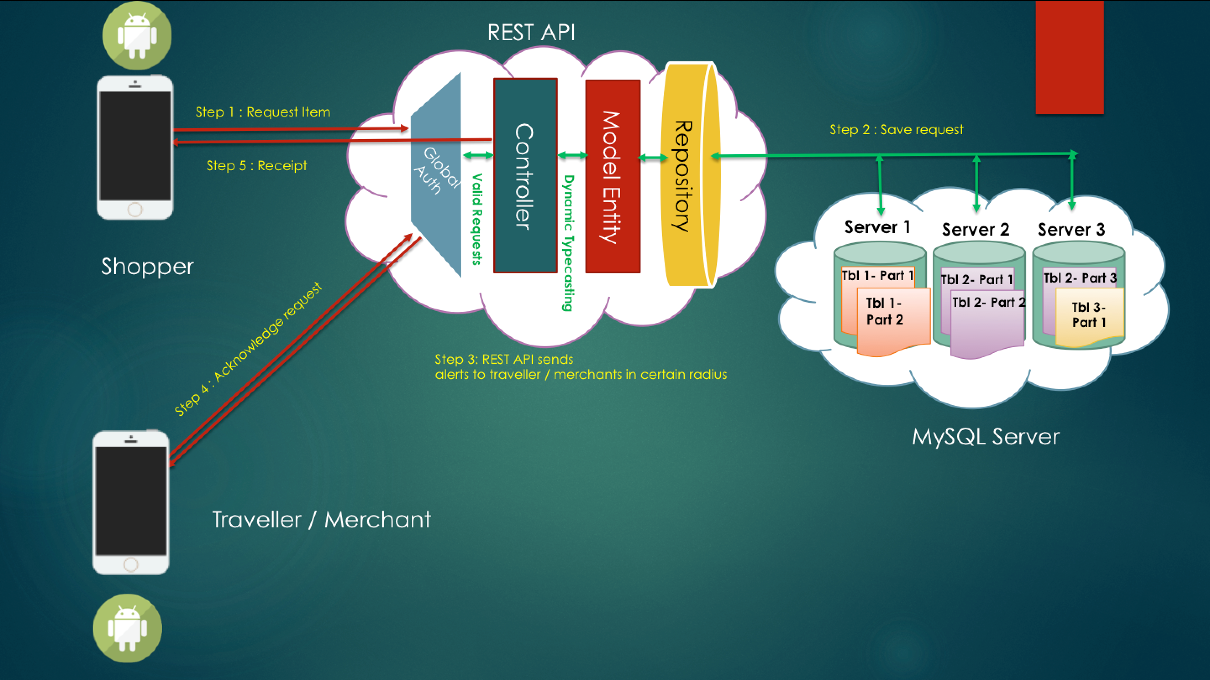
Architecture

Slide 6

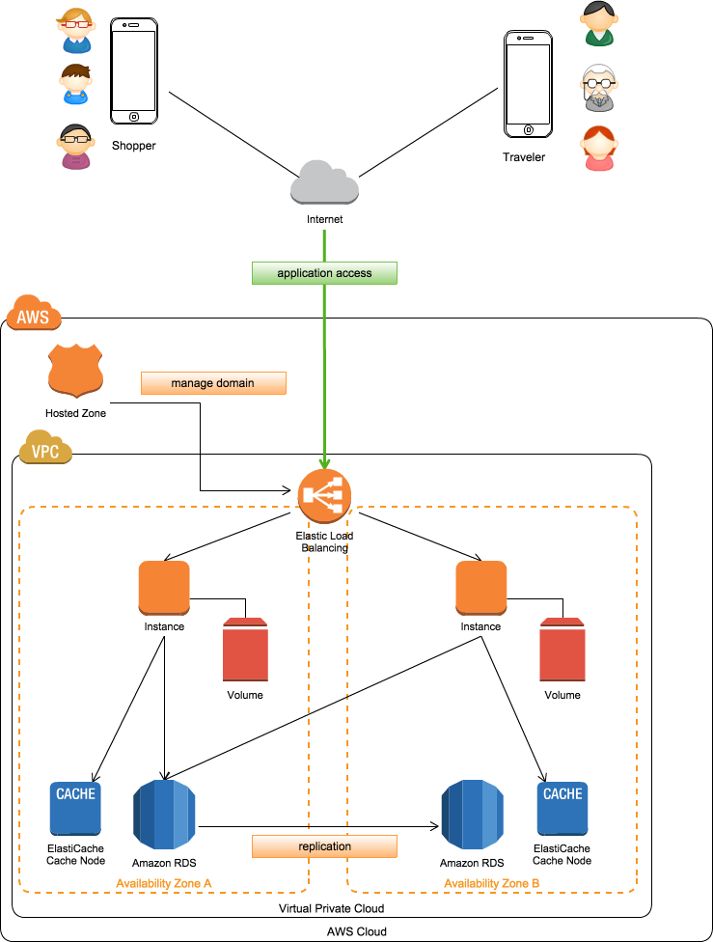
Deployment Architecture

Slide 7

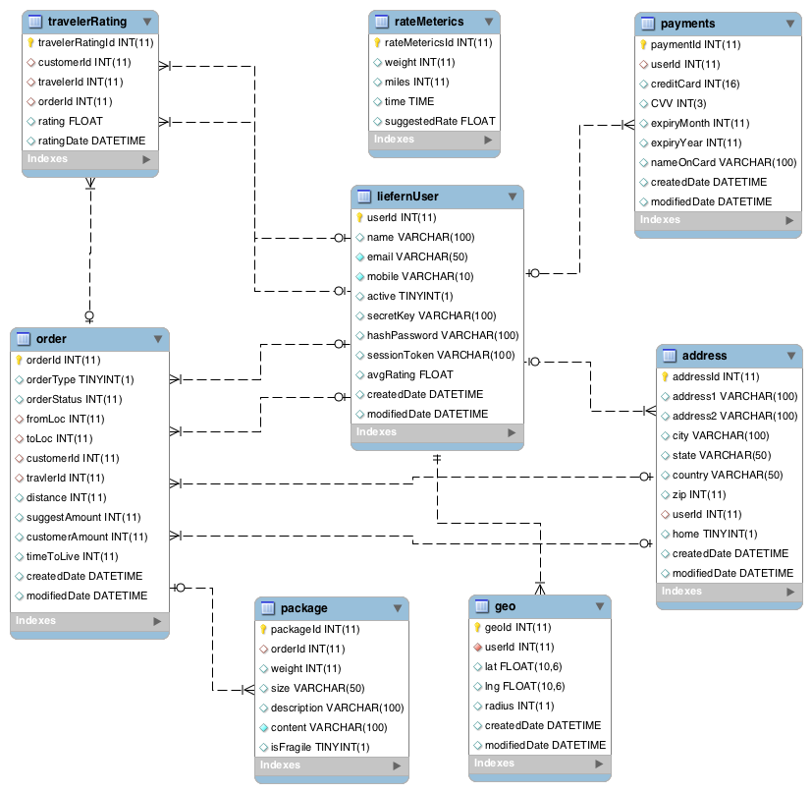
Database Architecture

Slide 8



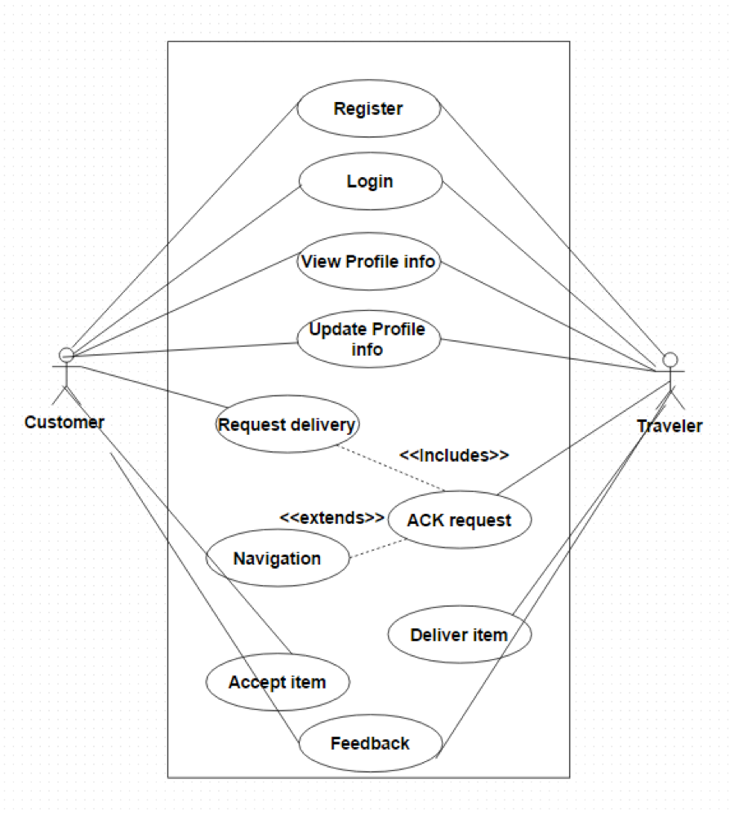

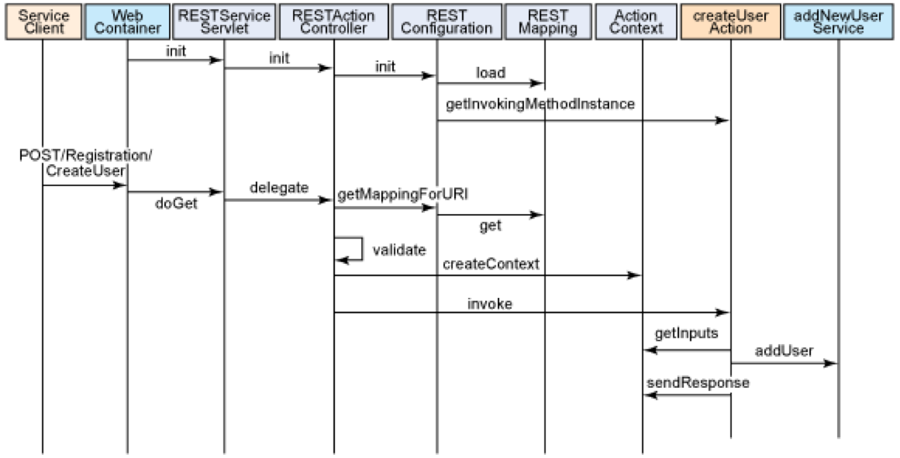
Methodology

Slide 9

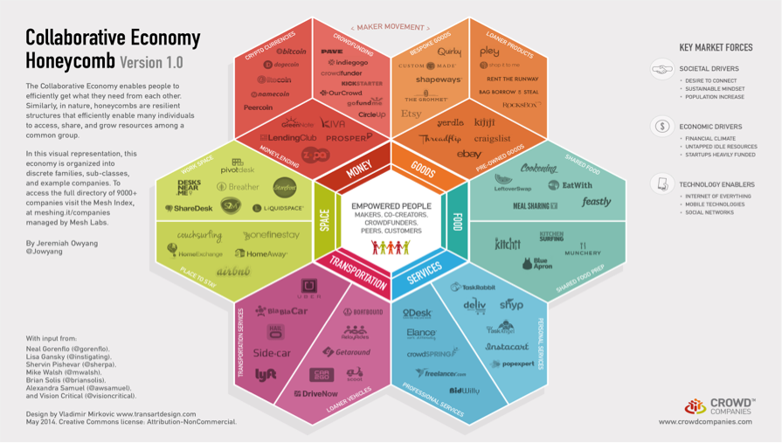


Economic Impact

Slide 10

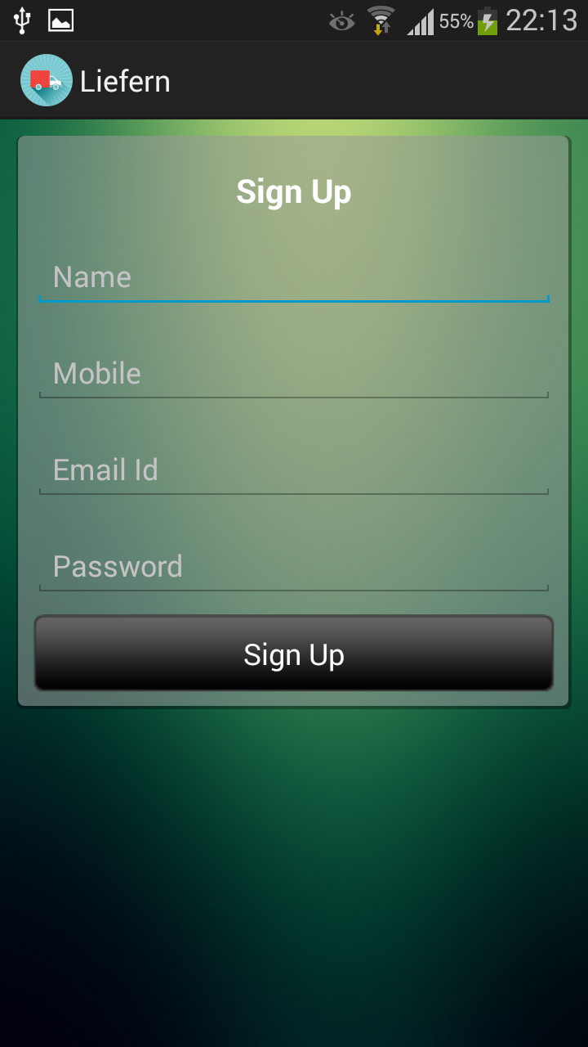
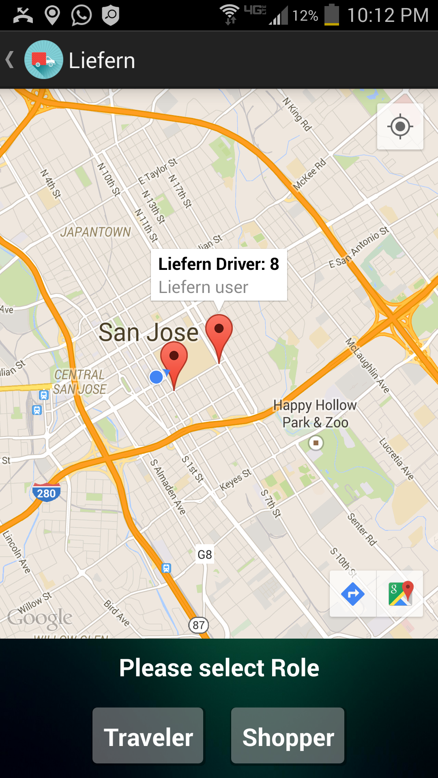
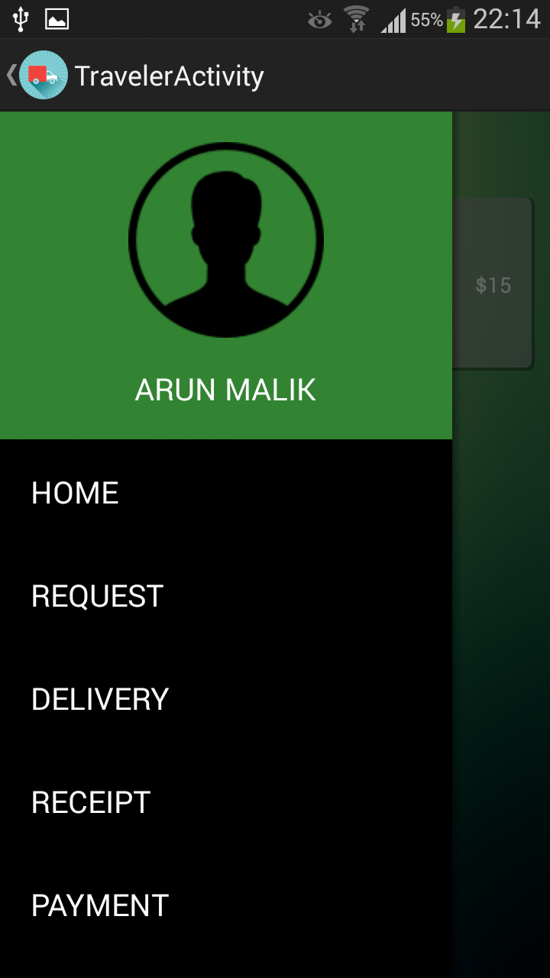
Mobile Application

Slide 11

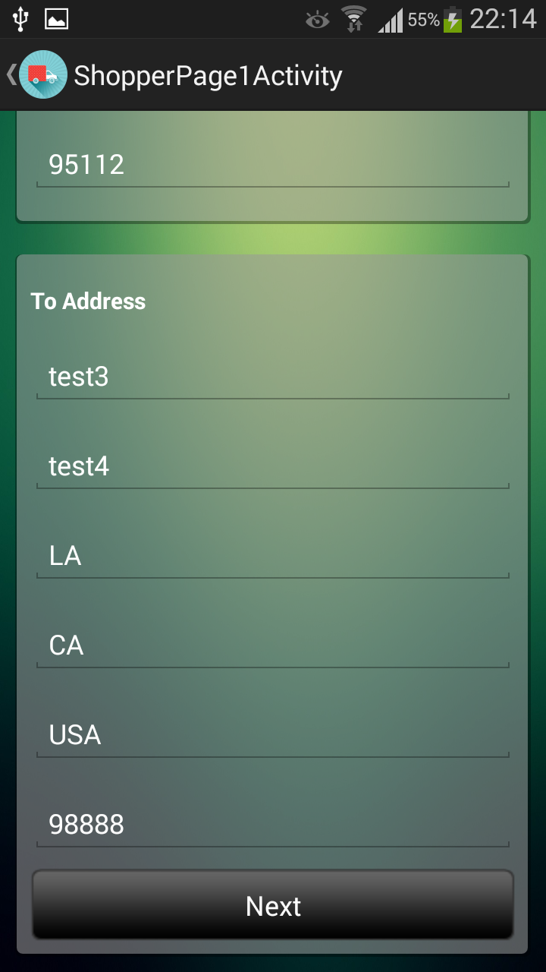
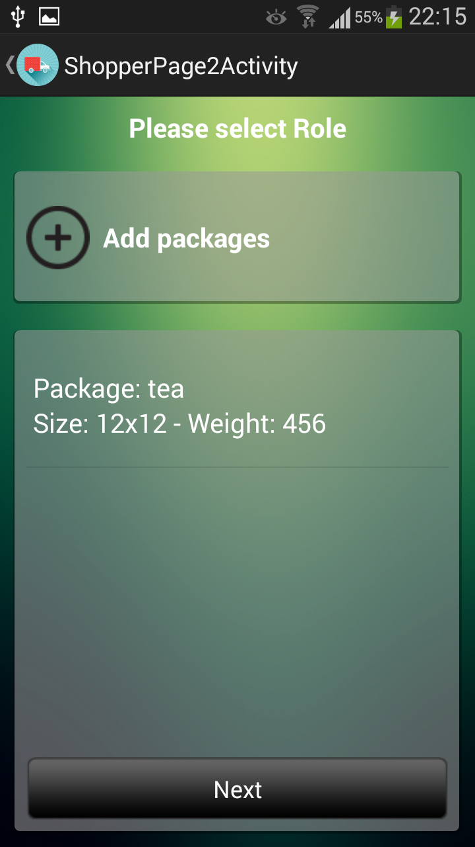
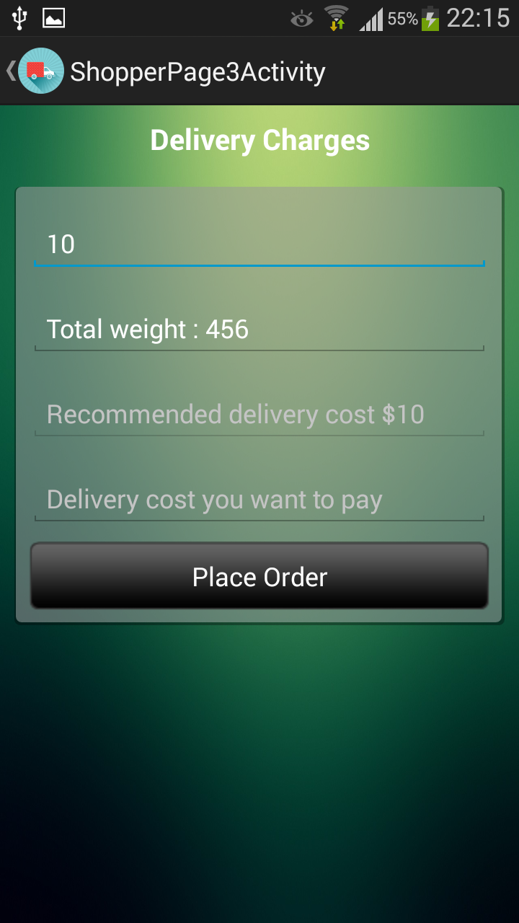
Mobile Application

Slide 12


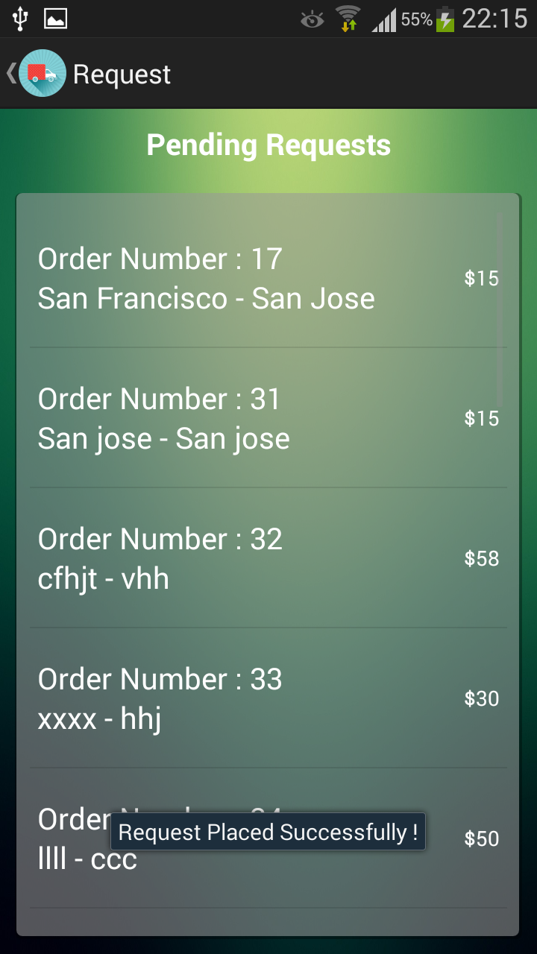
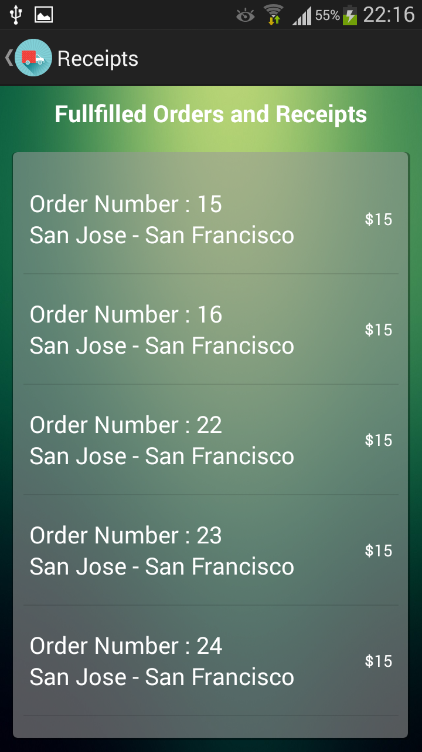
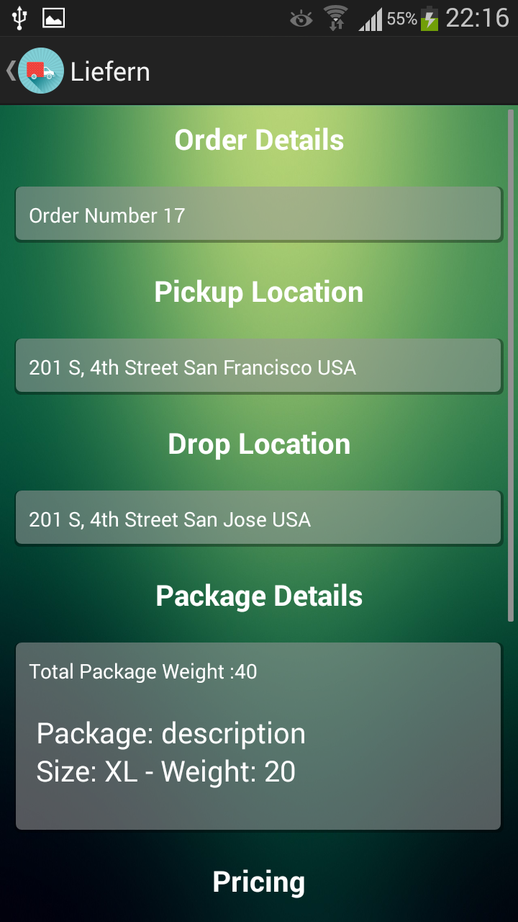
Mobile Application

Slide 13


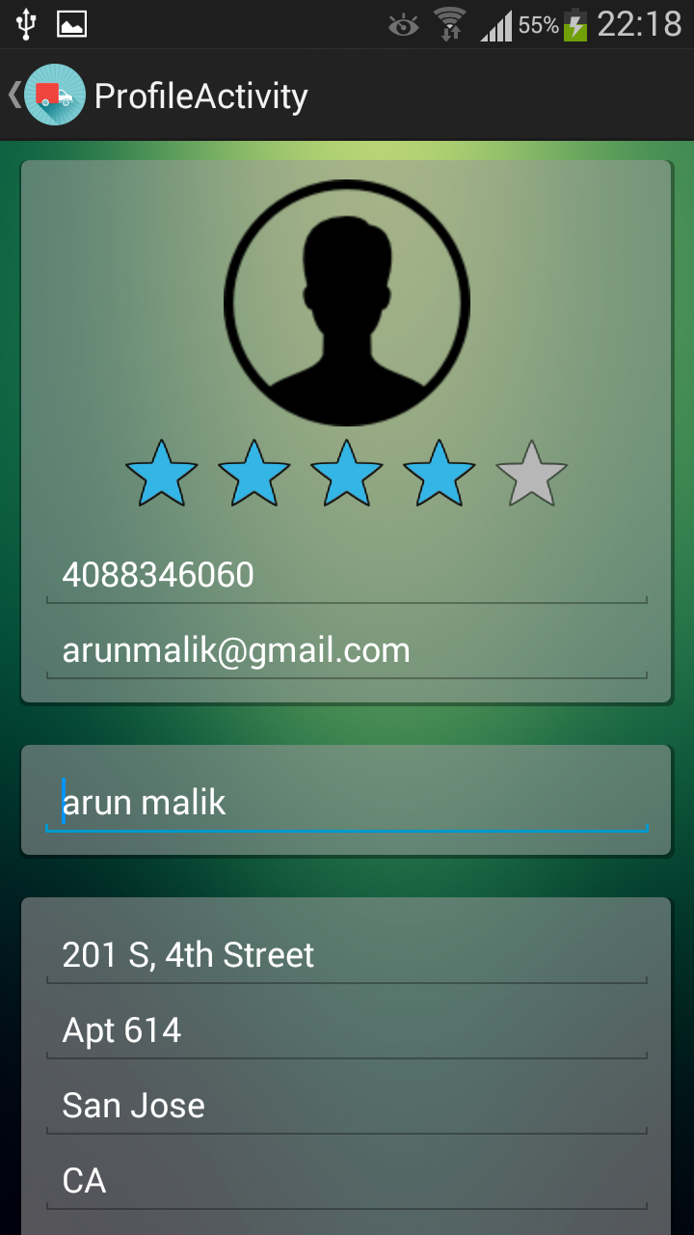
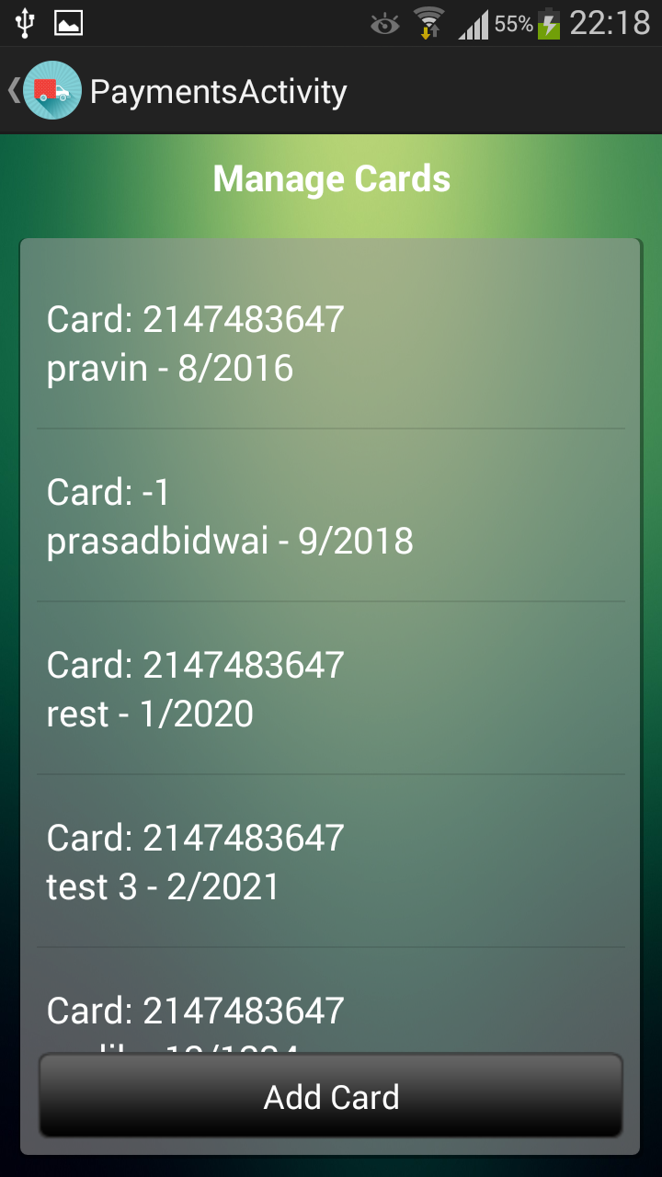
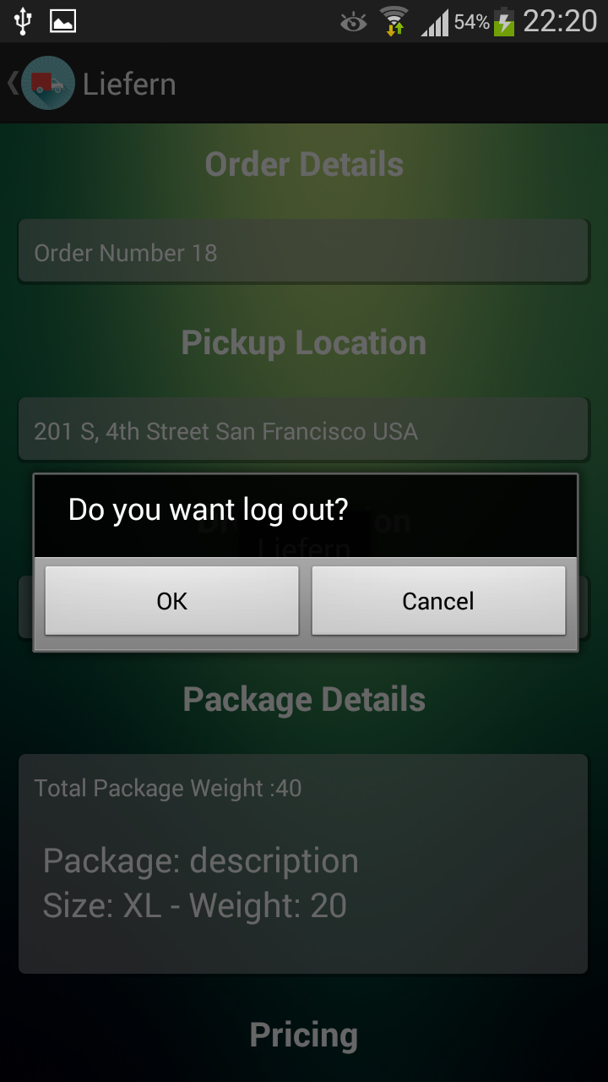
Mobile Application

Slide 14


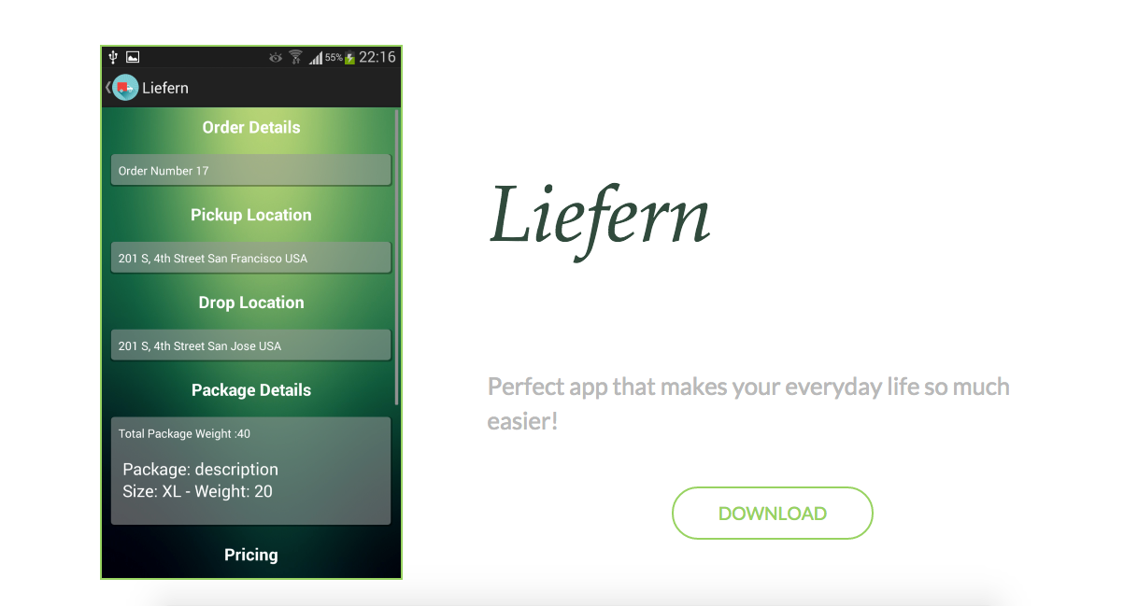
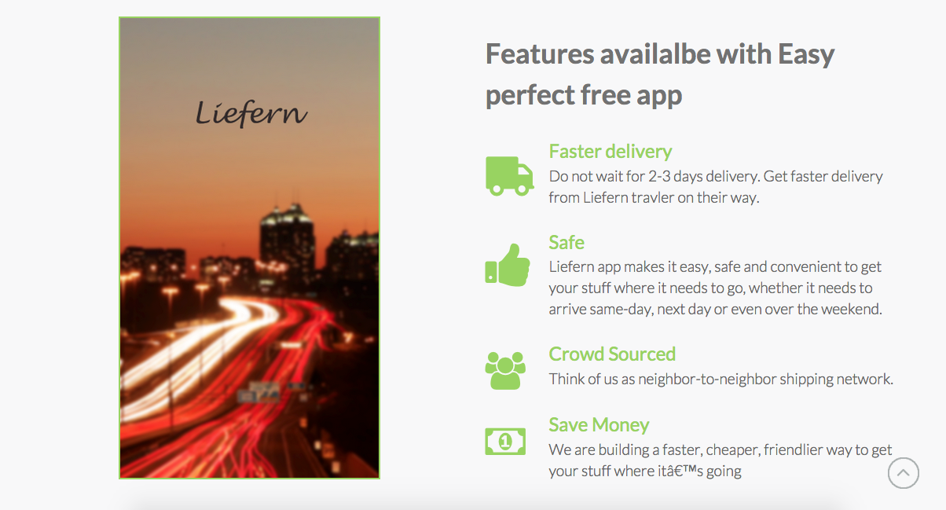


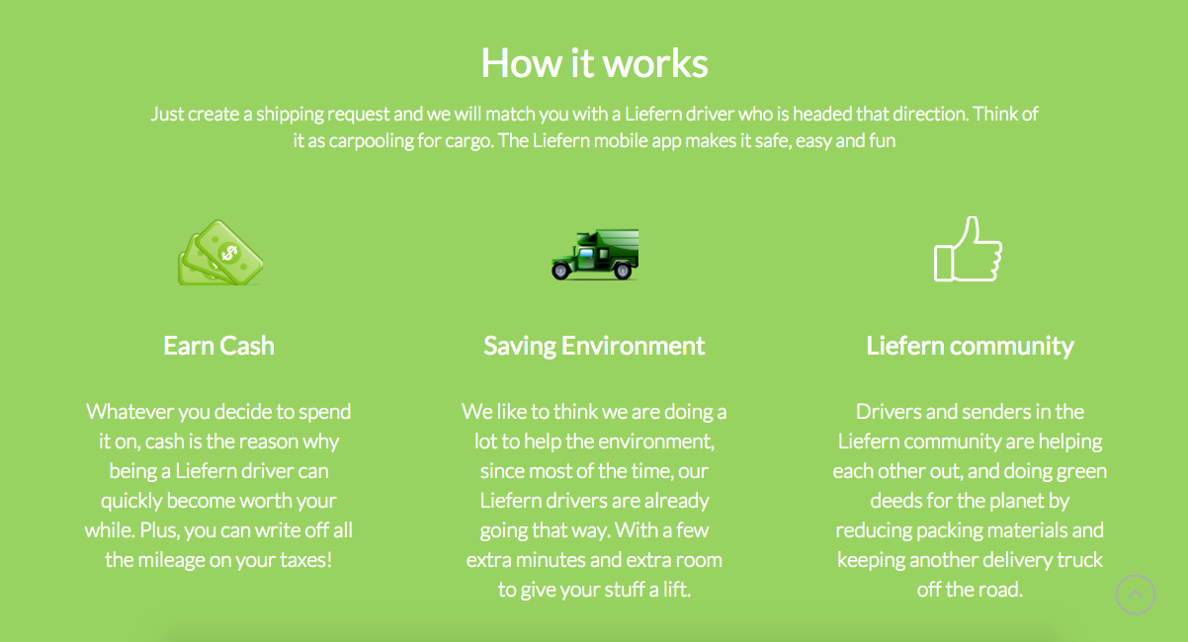
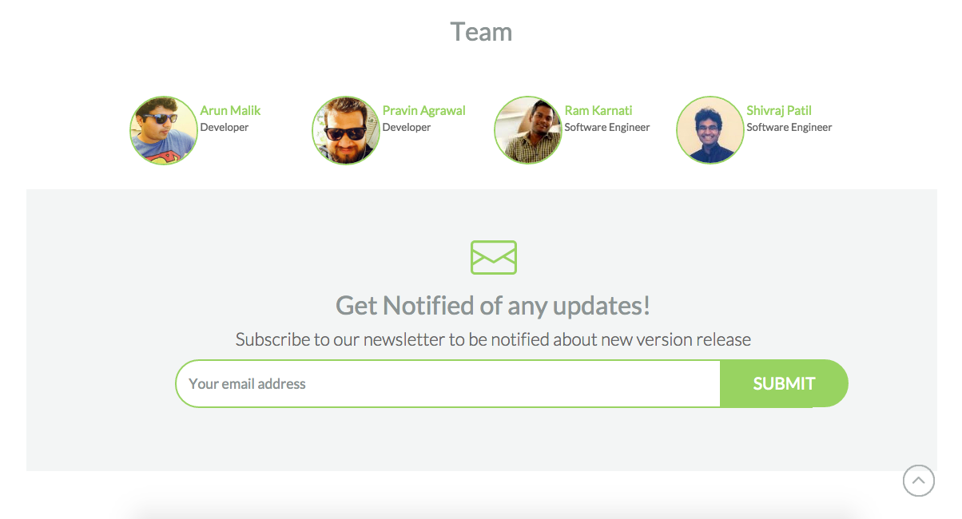
Website

Slide 15


Acknowledgement
We are thankful to
Professor Ashok Banerjee
Professor Dan Harkey
Dr. Jerry Gao
Professor Keith Perry
Dr. Lee Chang
Dr. Xiao Su
for their assistant and guidance in helping us materialize this project.

Slide 16


“Thank You.”

Slide 17









Slide 18









Slide 19









